Slide 1
Information Risk Management

Slide 2
IRM
Information risk management (IRM) is the process of identifying and assessing risk, reducing it to an acceptable level, and implementing the right mechanisms to maintain that level
There is no such thing as a 100-percent secure environment.
Every environment has vulnerabilities and threats. The skill is in identifying these threats, assessing the probability of them actually occurring and the damage they could cause, and then taking the right steps to reduce the overall risk

Slide 3
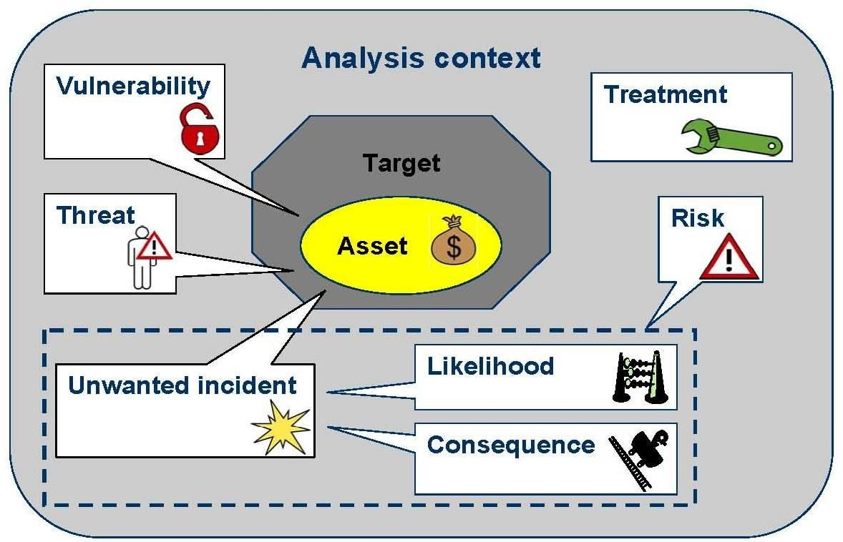
Elements of IRM

Slide 4


Assets
Safeguards
Data Facilities Hardware Software
Vulnerability
Threat
Risk
Vulnerability
Safeguards
Risk avoidance.
Risk transfer.
Risk mitigation.
Risk acceptance.

Slide 5




How IRM Works
Risk Assessment
Risk Mitigation
Select Safeguard*
Implement
Define Boundaries, Scope, and methodology
Collect and Synthesize Data
Interpret Results
Accept Residual Risk
Control

Slide 6
IRM Policy
Proper risk management requires a strong commitment from senior management, a documented process that supports the organization’s mission, an information risk management (IRM) policy, and a delegated IRM team
The IRM policy should be a subset of the organization’s overall risk management policy and should be mapped to the organizational security policies
The IRM policy should address the following items:

Slide 7
The objectives of the IRM team
The level of risk the organization will accept and what is considered an acceptable level of risk
Formal processes of risk identification
The connection between the IRM policy and the organization’s strategic planning processes
Responsibilities that fall under IRM and the roles to fulfill them
The mapping of risk to controls
The approach toward changing staff behaviors and resource allocation in response to risk analysis
The mapping of risks to performance targets and budgets
Key indicators to monitor the effectiveness of controls

Slide 8
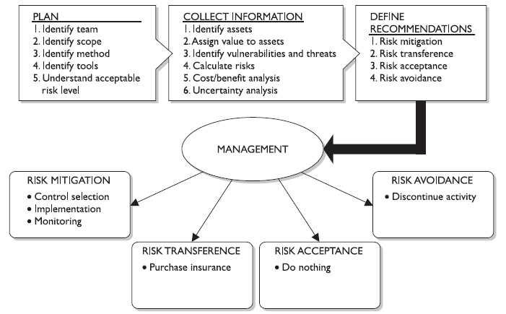
Risk Management Process

Slide 9
Risk Management Team
Each organization is different in its size, security posture, threat profile, and security budget. One organization may have one individual responsible for IRM or a team that works in a coordinated manner
The overall goal of the team is to ensure the company is protected in the most cost-effective manner
This goal can be accomplished only if the following components are in place:

Slide 10
An established risk acceptance level provided by senior management
Procedures for identifying and mitigating risks
Appropriate resource and fund allocation from senior management
Security-awareness training for all staff members associated with information assets
The mapping of legal and regulation compliancy requirements to control and implement requirements
The development of metrics and performance indicators so as to measure and manage various types of risks

Slide 11
Risk Assessment & Analysis
A risk assessment, which is really a part of risk management, is a method of identifying vulnerabilities and threats and assessing the possible impacts to determine where to implement security controls
A risk assessment is carried out, and the results are analyzed. Risk analysis is used to ensure that security is cost-effective, relevant, timely, and responsive to threats.
Risk analysis helps companies prioritize their risks and shows management the amount of resources that should be applied to protecting against those risks in a sensible manner.

Slide 12
Risk analysis has four main goals:
Identify assets and their value to the organization
Identify vulnerabilities and threats
Quantify the probability and business impact of these potential threats
Provide an economic balance between the impact of the threat and the cost of the countermeasure

Slide 13
Risk analysis provides a cost/benefit comparison, which compares the annualized cost of controls to the potential cost of loss.
A control, in most cases, should not be implemented unless the annualized cost of loss exceeds the annualized cost of the control itself. This means that if a facility is worth $100,000, it does not make sense to spend $150,000 trying to protect it

Slide 14
Scope of IRM
One of the risk analysis team’s tasks is to create a report that details the asset valuations. Senior management should review and accept the list, and make them the scope of the IRM project.
If management determines at this early stage that some assets are not important, the risk assessment team should not spend additional time or resources evaluating those assets
During discussions with management, everyone involved must have a firm understanding of the value of the security AIC triad—availability, integrity, and confidentiality—and how it directly relates to business needs

Slide 15
Management should outline the scope of the assessment, which most likely will be dictated by organizational compliance requirements as well as budgetary constraints
Many projects have run out of funds, and consequently stopped, because proper project sizing was not conducted at the onset of the project. Don’t let this happen

Slide 16
Team
Management will help decide upon team members
Should represent different departments
IT department
Auditors
Management
Physical security
Business unit leaders
Legal
Human Resources

Slide 17
Value of Information & Assets
The value placed on information is relative to the parties involved, what work was required to develop it, how much it costs to maintain, what damage would result if it were lost or destroyed, what enemies would pay for it, and what liability penalties could be endured
If a company does not know the value of the information and the other assets it is trying to protect, it does not know how much money and time it should spend on protecting them
The value of the company’s facilities must be assessed, along with all printers, workstations, servers, peripheral devices, supplies, and employees. You do not know how much is in danger of being lost if you don’t know what you have and what it is worth in the first place

Slide 18
Cost That Makes up the Value
An asset can have both quantitative and qualitative measurements assigned to it, but these measurements need to be derived
The actual value of an asset is determined by the importance it has to the organization as a whole
The value of an asset should reflect all identifiable costs that would arise if the asset were actually impaired
If a server cost $4,000 to purchase, this value should not be input as the value of the asset in a risk assessment
Rather, the cost of replacing or repairing it, the loss of productivity, and the value of any data that may be corrupted or lost must be accounted for to properly capture the amount the organization would lose if the server were to fail

Slide 19
The following issues should be considered when assigning values to assets:
Cost to acquire or develop the asset
Cost to maintain and protect the asset
Value of the asset to owners and users
Value of the asset to adversaries
Price others are willing to pay for the asset
Cost to replace the asset if lost
Operational and production activities affected if the asset is unavailable
Liability issues if the asset is compromised
Usefulness and role of the asset in the organization

Slide 20
Why to determine Asset Value?
It helps
To perform effective cost/benefit analyses
To select specific countermeasures and safeguards
To determine the level of insurance coverage to purchase
To understand what exactly is at risk
To comply with legal and regulatory requirements

Slide 21
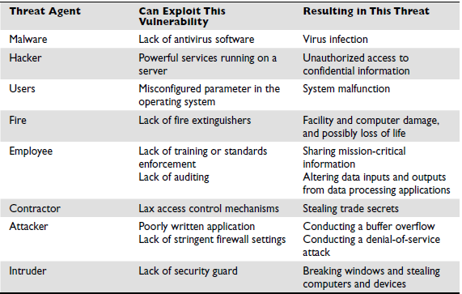
Threats & Vulnerabilities

Slide 22
Loss Potential
What the company would lose if a threat agent actually exploited a vulnerability. The loss may be corrupted data, destruction of systems and/or the facility, unauthorized disclosure of confidential information, a reduction in employee productivity, and so on
Delayed Loss
Delayed loss is secondary in nature and takes place well after a vulnerability is exploited. Delayed loss may include damage to the company’s reputation, loss of market share, accrued late penalties, civil suits, the delayed collection of funds from customers, and so forth

Slide 23
Risk Analysis Approaches
The two approaches to risk analysis are quantitative and qualitative.
Quantitative: A quantitative risk analysis is used to assign monetary and numeric values to all elements of the risk analysis process. Each element within the analysis (asset value, threat frequency, severity of vulnerability, impact damage, safeguard costs, safeguard effectiveness, uncertainty, and probability items) is quantified and entered into equations to determine total and residual risks. It is more of a scientific or mathematical approach to risk analysis compared to qualitative

Slide 24
Risk Analysis Approaches
Qualitative: A qualitative risk analysis uses a “softer” approach to the data elements of a risk analysis. It does not quantify that data, which means that it does not assign numeric values to the data so that they can be used in equations.
As an example, the results of a quantitative risk analysis could be that the organization is at risk of losing $100,000 if a buffer overflow was exploited on a web server, $25,000 if a database was compromised, and $10,000 if a file server was compromised.
A qualitative risk analysis would not present these findings in monetary values, but would assign ratings to the risks, as in Red, Yellow, and Green

Slide 25
A quantitative analysis uses risk calculations that attempt to predict the level of monetary losses and the probability for each type of threat.
Qualitative analysis does not use calculations. Instead, it is more opinion- and scenario-based and uses a rating system to relay the risk criticality levels.
Quantitative and qualitative approaches have their own pros and cons, and each applies more appropriately to some situations than others.

Slide 26
Steps of Quantitative Risk Analysis
If we choose to carry out a quantitative analysis, then we are going to use mathematical equations for our data interpretation process. The most commonly used equations used for this purpose are the single loss expectancy (SLE) and the annual loss expectancy (ALE).
Exposure Factor: The exposure factor (EF) represents the percentage of loss a realized threat could have on a certain asset. For example, if a data warehouse has the asset value of $150,000, it can be estimated that if a fire were to occur, 25 percent of the warehouse would be damaged

Slide 27
Single Loss Expectancy: The SLE is a dollar amount that is assigned to a single event that represents the company’s potential loss amount if a specific threat were to take place. The equation is laid out as follows:
Asset Value × Exposure Factor (EF) = SLE
So, for the previous example, SLE would be $37,500
Asset Value ($150,000) × Exposure Factor (25%) = $37,500
This tells us that the company can potentially lose $37,500 if a fire took place. But we need to know what our annual potential loss is, since we develop and use our security budgets on an annual basis.

Slide 28
This is where the ALE equation comes into play. The ALE equation is as follows:
SLE × Annualized Rate of Occurrence (ARO) = ALE
The annualized rate of occurrence (ARO) is the value that represents the estimated frequency of a specific threat taking place within a 12-month timeframe. The range can be from 0.0 (never) to 1.0 (once a year) to greater than 1 (several times a year) and anywhere in between. For example, if the probability of a fire taking place and damaging our data warehouse is once every ten years, the ARO value is 0.1

Slide 29
So, if a fire taking place within a company’s data warehouse facility can cause $37,500 in damages, and the frequency (or ARO) of a fire taking place has an ARO value of 0.1 (indicating once in ten years), then the ALE value is $3,750 ($37,500 × 0.1 = $3,750).
The ALE value tells the company that if it wants to put in controls to protect the asset (warehouse) from this threat (fire), it can sensibly spend $3,750 or less per year to provide the necessary level of protection
It would not make good business sense for the company to spend more than $3,750 per year to protect itself from this threat.

Slide 30
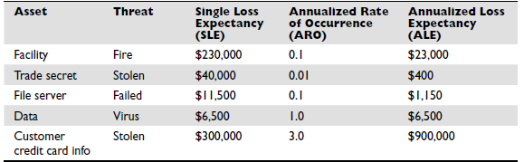
Because the company has a risk of losing up to $6,500 if data is corrupted by virus infiltration, up to this amount of funds can be earmarked toward providing antivirus software and methods to ensure that a virus attack will not happen.

Slide 31
Example
Richman Investments provides high-end smartphones to several employees. The value of each smartphone is $500, and approximately 1,000 employees have these company-owned devices. In the past year, employees have lost or damageed 75 smartphones
Calculate
ALE
ARO
SLE

Slide 32
A company owns 5000 employees and each own company’s laptop od worth 5000$. Each laptop contains the data of worth 40,000$. “losing laptops with an average of 100 personal records on them”. We think there is a chance of losing 20 laptops each year in our organization, and each laptop on average could have 100 personal records on it.
Asset Value (AV): $5,000 (Laptop) + $40,000 (PII data) = $45,000
o The laptop value itself is $5,000
o Each personal record costs around $400 on global reports ($400 x 100 = $40,000)
· Exposure Factor (EF): 1 (100% since the laptop is lost not only part of it)
· Single Loss Expectancy (SLE) = 1 (EF) x $45,000 (AV) = $45,000
· Annual Rate of Occurrence (ARO): 20 (Assuming 20 laptops is lost per year)
· Annualized Loss Expectancy (ALE) = 20 (ARO) x $45,000 (EF) = $900,000
Notes:
Asset Value (AV): $5,000 (Laptop) + $40,000 (PII data) = $45,000
o The laptop value itself is $5,000
o Each personal record costs around $400 on global reports ($400 x 100 = $40,000)
· Exposure Factor (EF): 1 (100% since the laptop is lost not only part of it)
· Single Loss Expectancy (SLE) = 1 (EF) x $45,000 (AV) = $45,000
· Annual Rate of Occurrence (ARO): 20 (Assuming 20 laptops is lost per year)
· Annualized Loss Expectancy (ALE) = 20 (ARO) x $45,000 (EF) = $900,000

Slide 33
Qualitative Risk Analysis
Qualitative methods walk through different scenarios of risk possibilities and rank the seriousness of the threats and the validity of the different possible countermeasures based on opinions. (A wide sweeping analysis can include hundreds of scenarios.)
Qualitative analysis techniques include judgment, best practices, intuition, and experience. Examples of qualitative techniques to gather data are brainstorming, focus groups, surveys, questionnaires, checklists, one-on-one meetings, and interviews
The risk analysis team will determine the best technique for the threats that need to be assessed, as well as the culture of the company and individuals involved with the analysis

Slide 34
The team that is performing the risk analysis gathers personnel who have experience and education on the threats being evaluated. When this group is presented with a scenario that describes threats and loss potential, each member responds with their gut feeling and experience on the likelihood of the threat and the extent of damage that may result.
A scenario of each identified vulnerability and how it would be exploited is explored. The “expert” in the group, who is most familiar with this type of threat, should review the scenario to ensure it reflects how an actual threat would be carried out

Slide 35
Safeguards that would diminish the damage of this threat are then evaluated, and the scenario is played out for each safeguard. The exposure possibility and loss possibility can be ranked as high, medium, or low on a scale of 1 to 5 or 1 to 10
Once the selected personnel rank the possibility of a threat happening, the loss potential, and the advantages of each safeguard, this information is compiled into a report and presented to management to help it make better decisions on how best to implement safeguards into the environment

Slide 36
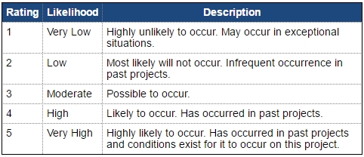

Slide 37
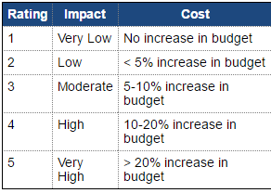

Slide 38
Threat Likelihood | Impact
 | Low (10) | Medium (50) | High (100)
High (1.0) | Low 10 x 1.0 = 10 | Medium 50 x 1.0 = 50 | High 100 x 1.0 = 100
Medium (0.5) | Low 10 x 0.5 = 5 | Medium 50 x 0.5 = 25 | Medium 100 x 0.5 = 50
Low (0.1) | Low 10 x 0.1 = 1 | Low 50 x 0.1 =5 | Low 100 x 0.1 = 10

Slide 39
Risk Assessment Matrix
Impact | Likelihood
 | 1 Rare | 2 Unlikely | 3 Moderate | 4 Likely | 5 Frequent
5. Extreme
4. Very High
3. Major
2. Low/Minor
1. Negligible

Slide 40
Catastrophic (5)
Material (4)
Major (3)
Minor (2)
Insignificant
(1)
Impact
Rare(1)
Unlikely(2)
Moderate(3)
Likely (4)
Frequent(5)
Likelihood

Slide 41
The benefit of this type of analysis are that communication must happen among team members to rank the risks, safeguard strengths, and identify weaknesses, and the people who know these subjects the best provide their opinions to management
Example: The risk analysis team presents a scenario explaining the threat of a hacker accessing confidential information held on the five file servers within the company. The risk analysis team then distributes the scenario in a written format to a team of five people (the IT manager, database administrator, application programmer, system operator, and operational manager), who are also given a sheet to rank the threat’s severity, loss potential, and each safeguard’s effectiveness,

Slide 42
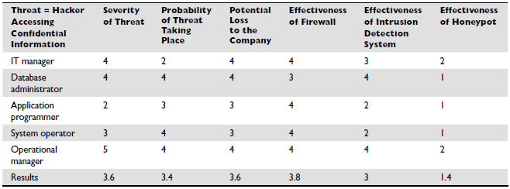
This data is compiled and inserted into a report and presented to management. When management is presented with this information, it will see that its staff (or a chosen set) feels that purchasing a firewall will protect the company from this threat more than purchasing an intrusion detection system or setting up a honeypot system.
This is the result of looking at only one threat, and management will view the severity, probability, and loss potential of each threat so it knows which threats cause the greatest risk and should be addressed first.

Slide 43
Qualitative Cons:
The assessments and results are subjective and opinion-based
Eliminates the opportunity to create a dollar value for cost/benefit discussions
Hard to develop a security budget from the results because monetary values are not used
Standards are not available. Each vendor has its own way of interpreting the processes and their results

Slide 44
Quantitative Cons:
Calculations can be complex. Can management understand how these values were derived?
Without automated tools, this process is extremely laborious
More preliminary work is needed to gather detailed information about the environment
Standards are not available. Each vendor has its own way of interpreting the processes and their results

Slide 45
Control Selection
A security control must make good business sense, meaning it is cost-effective (its benefit outweighs its cost). This requires another type of analysis: a cost/benefit analysis
(ALE before implementing safeguard) – (ALE after implementing safeguard) – (annual cost of safeguard) = value of safeguard to the company
For example, if the ALE of the threat of a hacker bringing down a web server is $12,000 prior to implementing the suggested safeguard, and the ALE is $3,000 after implementing the safeguard, while the annual cost of maintenance and operation of the safeguard is $650, then the value of this safeguard to the company is $8,350 each year

Slide 46
Cost of Control
The cost of a countermeasure is more than just the amount filled out on the purchase order. The following items should be considered and evaluated when deriving the full cost of a countermeasure
Product costs
Design/planning costs
Implementation costs
Environment modifications
Compatibility with other countermeasures
Maintenance requirements
Testing requirements
Repair, replacement, or update costs
Operating and support costs
Effects on productivity
Subscription costs
Extra man-hours for monitoring and responding to alerts
Beer for the headaches that this new tool will bring about

Slide 47
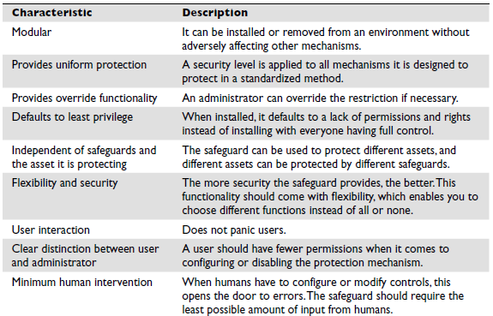
Functionality & Effectiveness of Counter Measure

Slide 48
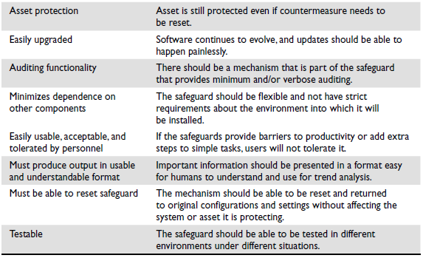

Slide 49
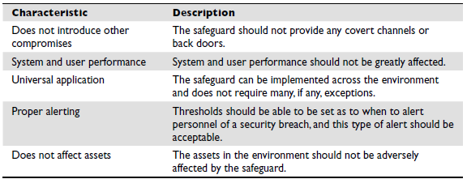

Slide 50
Total Risk vs. Residual Risk
The reason a company implements countermeasures is to reduce its overall risk to an acceptable level. As stated earlier, no system or environment is 100 percent secure, which means there is always some risk left over to deal with. This is called residual risk.
Residual risk is different from total risk, which is the risk a company faces if it chooses not to implement any type of safeguard. A company may choose to take on total risk if the cost/benefit analysis results indicate this is the best course of action
For example, if there is a small likelihood that a company’s web servers can be compromised, and the necessary safeguards to provide a higher level of protection cost more than the potential loss in the first place, the company will choose not to implement the safeguard, choosing to deal with the total risk

Slide 51
Risk Avoidance. Is the practice of coming up with alternatives so that the risk in question is not realized.
Risk Transfer. Is the practice of passing on the risk in question to another entity, such as an insurance company.
Risk Mitigation. Is the practice of eliminating or significantly decreasing the level of risk presented. E.g., company can put countermeasure such as firewall, IDS etc. in place to deter malicious from accessing the highly sensitive information.
Risk Acceptance. Is the practice of simply accepting certain risk (s), typically based on a business decision that may also weigh the cost versus the benefit of dealing with the risk in another way.

Slide 52

Avoidance
 Attempts to prevent exploitation of the vulnerability
 The practice of eliminating the risk by withdrawing from or not becoming involved in the activity that allows the risk to be realized.
 For example, an organization decides to discontinue a business process in order to avoid a situation that exposes the organization to risk

Slide 53
Transference
 Control approach that attempts to shift risk to other assets, processes, or organizations
 If lacking, organization should hire individuals/firms that
provide security management and administration expertise
experienced in dealing with those risks
 Organization | may then | transfer | risk associated with
management | of complex | systems | to another organization

Slide 54
Mitigation
 Attempts to reduce impact of through planning and preparation
vulnerability
exploitation
 Often this will include selecting countermeasures that will either reduce the likelihood of occurrence or reduce the severity of loss, or achieve both objectives at the same time
 Countermeasures can include technical or operational
controls or changes to the physical environment.
 When evaluating the strength of a control, consideration should be given to whether the controls are preventative or detective.

Slide 55
Acceptance
 Doing nothing to protect a vulnerability and accepting the outcome of its exploitation
 Valid only when the particular function, service, information, or
asset does not justify cost of protection
 Risk appetite describes the degree to which organization is willing to accept risk as trade-off to the expense of applying controls

